Slide 1
Twist onboarding presentation –Capgemini & Oracle consultants 01 January 2016

Slide 2
Agenda
Twist project overview
Transformation targets
Project Principles
Organisation charts
Working methods and tools to use:
Encrypted emails
Telia Workroom
TeamForge
Clarity
Diva
Jira
Confluence
Practicalities in Farsta:
Seating arrangements
Book rooms
Printing
Access Card
The intention of this document is to facilitate the onboarding of new consultants to the Twist project.

Slide 3
Twist project overview

Slide 4

Telia´s overall transformation targets
Transformation targets 2018
Purpose of the Transformation initiatives is to increase cost efficiency by…
80% less products and offerings
100% of customers on target portfolio
50% of service and sales online
Relational NPS of +50
2000 rural sites closed and 75 top tech sites optimised
50% less IT systems
…reducing complexity in operations , driven by large range product offers available to all customers
… moving towards consistent customer interactions across all channels
… modernising and digitising processes from E2E view thereby also improving the customer experience
… migrating, optimising and cleaning-out the existing network
… preparing IT platforms for the future

Slide 5


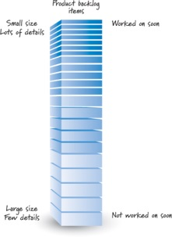
Twist project principles
Quickly get to a starting point for improvement
Relentlessly improve what we do and how it’s done
Project Backlog for scope handling
Detailed planning 3-months rolling
vs

Slide 6
Organisation charts

Slide 7
Operations
Twist Project Steering Group
Twist PO Team
Rollout
Facilitation – Karl Aronsson (CG)
Prep. team
Product Model
Release handling (including Env. & Maint. Establishment)
Site Practice Ground
Lisa Andersson (TS) / Anders Hässel (CG)
Market & Sell
TL/KM – Kristina Wilken (TS), OPO – Karin Westlin (TS)
Deliver & Install
TL/KM – Cecilia Österman (TS), OPO – Therese Falk (TS)
Bill & Collect
TL - Lena Svensson (TS), xx - Max Karlberg (TS)
SP – Anna Mörk (TS), KO – Annica Torkelsson (TS)
TL/KM – Cathrin Hallberg (TS), OPO – Kristian Möller (TS)
TL - Tobias Larsson (CG)
Service & Support
TL – Claes Timner (CG), OPO – Viktor Salmonsson (CG), KM – Max Karlberg (TS)
TL/KM – Karin Anderberg (TS), OPO – Johan Särnholm (TS)
RODOD Implementation & Delivery
Claes de Berg (CG)
Online channels (capacity in existing OL teams)
Project functions:
Sukumaran Israel – Twist PMO – Onsite and Offshore
Emma Andersson – project internal comm’s (CG)
Anders Eklund – Agile Strategic Steering Model (Ext)
NN – Financial support
Per Abrahamsson – Procurement support (TS)
Fredrik Säll, Charlie Burman, Shahram Koulahi – Procurement (TS)
Marie Hvass – Administrative support (TS)
Release plan
Other related projects & initiatives
Other related projects & initiatives
Other related projects & initiatives
Rollout plan

Slide 8
Leading project roles for each team
Manage detailed prioritization of team backlog (overall prio in PO Team)
Operational link to PO team
Represents team in PO team meetings
Accountable for backlog item analysis, breakdown, definition, acceptance criteria
Raise Gaps to Arbitration board
Operational PO (OPO)
“Content focus”
Team Lead (TL)
“People focus”
Kanban Master (KM)
Serve as team method support & driver (inside team and towards team stakeholders)
Manage flow optimization
Manage team work and progress visualization
Manage team retrospectives
Protecting the team from being over-burdened
Overall team responsible
Resource management
Risk and issue management
Status reporting
Manage Daily Stand-up
Team representative in project
meetings
“Method focus”

Slide 9
Working methods and tools to use -Encrypted and signed emails

Slide 10
How to send/recieve a signed and encrypted email?
Summary
To be able to send and receive an encrypted email you need to download Capgemini’s own certificate and exchange the key with Telia. You will find step by step instructions here:
https://coconet.capgemini.com/sf/go/doc9070204
OBS! After installing the certificate make sure to exchange the key with Marie Hvass (marie.hvass@teliasonera.com) who is in charge of creating your Telia profile and require to send your credentials encrypted.

Slide 11
Working methods and tools to use -Telia Workroom

Slide 12
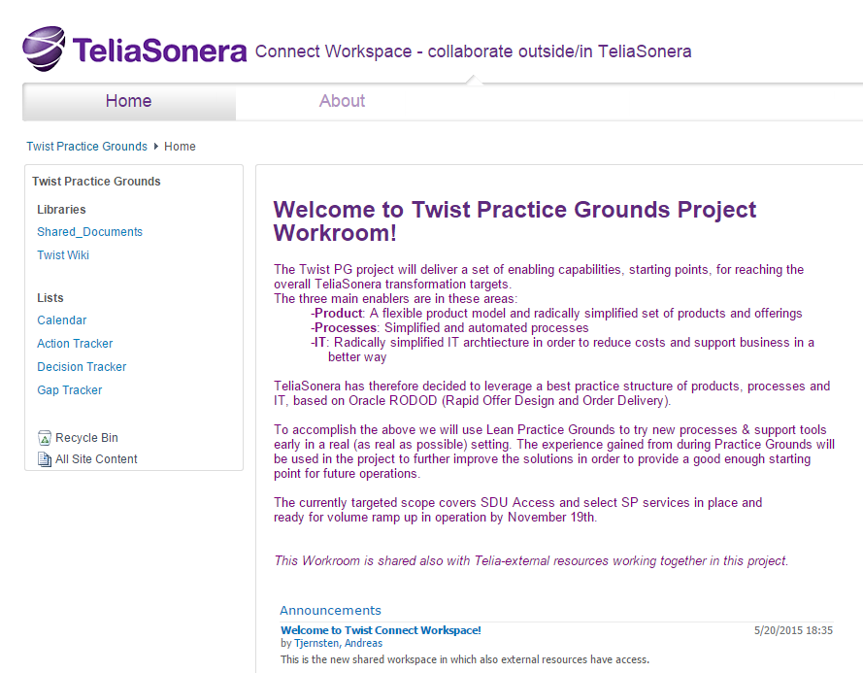
Twist Practice Grounds Project Workroom (1/2)
What is it?
Workroom is the common repository for project documentation and tracking.
Get access
1. Workroom access is provided by Capgemini PMO
2. Use mobile to get login password for each log in

Slide 13
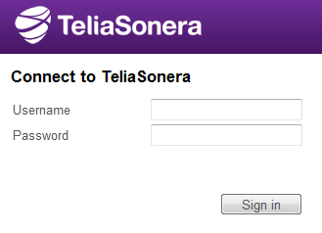
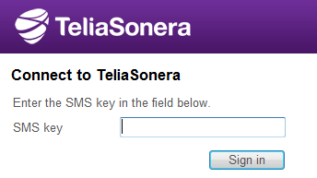
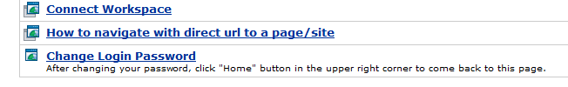
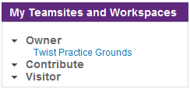
How to log on to Workroom (2/2)
1
https://connect.teliasonera.com/dana-na/auth/url_2/welcome.cgi
Click the link
Enter your username provided in your confirmation email (e.g. CAP_XXXXX)
Enter the password you permanently set at first log in.
Within a few seconds you will receive a sms with a numeric password which you enter in the field ”SMS Key”.
Choose ”Connect Workspace” in the list.
Scroll down to ”My Workrooms” and press ”Twist Practice Grounds”
2-3
4
5
6

Slide 14
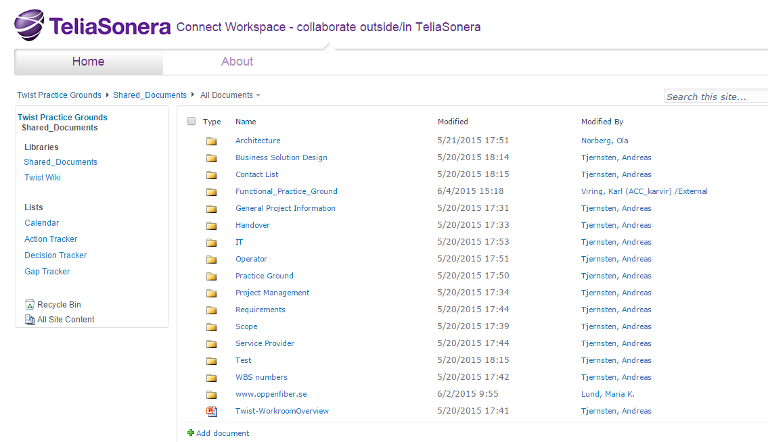
Overview of Workroom´s folder structure
Workroom contains folders for different streams and areas of work/information. This is where general project information is located together with working material within the project as well as stream deliverables.

Slide 15
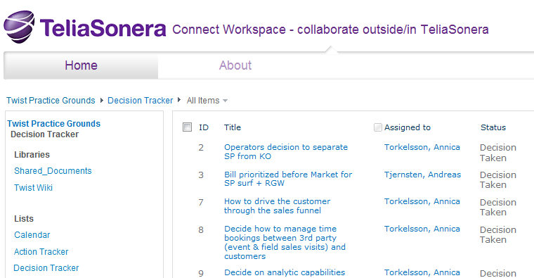
Trackers -Logging decisions in Workroom (1/2)
The Decision tracker has two purposes, to track Decisions taken and to raise requests for decisions in specific areas.
Project decisions taken or in progress are to be tracked by a member in the Project Management team and requests for decisions could be raised by a Project Management team member or any team/stream lead.
Decision material needs to be attached, see next slide for more info.
Link to DT:
https://connect.teliasonera.com/sites/Twist_PG/Lists/Decision%20Tracker/,DanaInfo=connectspace.teliasonera.net+AllItems.aspx

Slide 16
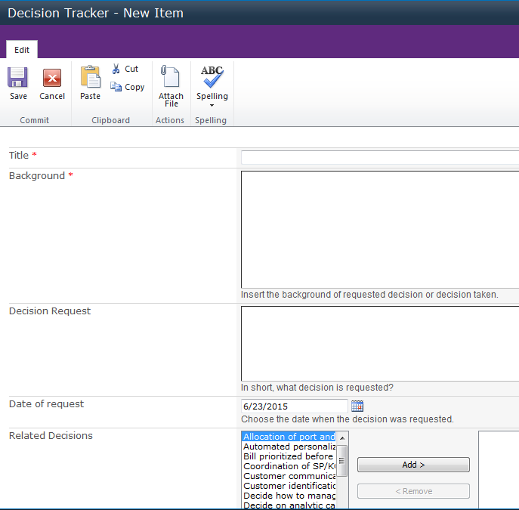
Trackers -Logging decisions in Workroom (2/2)
How to log a decision
When tracking a decision these are the Required fields when using the Decision tracker:
• Title
• Decision Taken
• Status
• Date for decision requested/decision taken
• Decision maker
• If applicable always attach any related documents (usually as ppt.)
Alternative Solutions and Background are not required fields for decisions that already have been made but for Decision Requests; fill these fields out as appropriate for the request.
Make sure to notify the “Assigned to” to make him/her aware of it’s assignment.

Slide 17
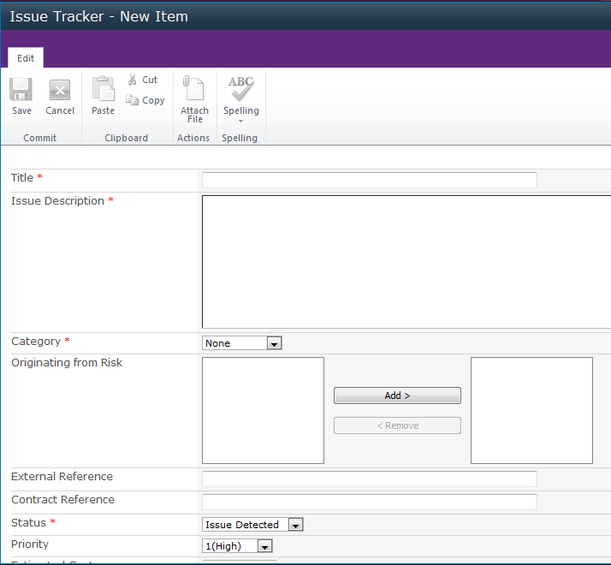
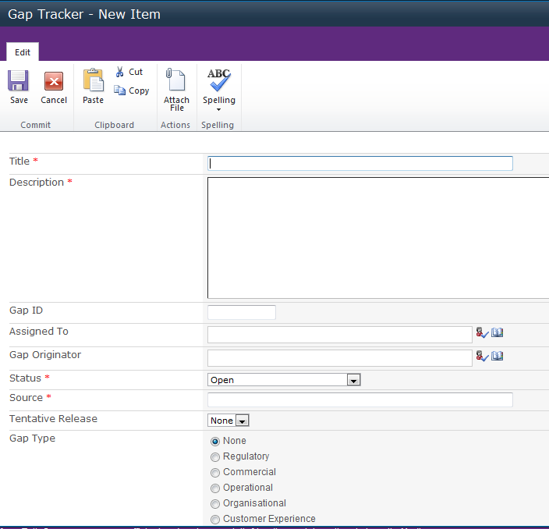
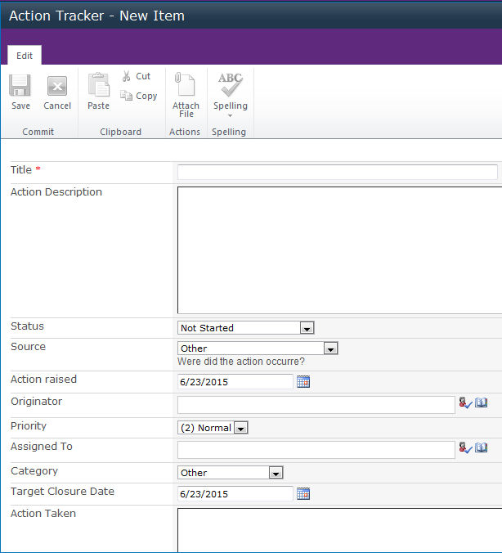
Trackers -In workroom there are several trackers filling different purposes
Action tracker:
Twist workroom contains an Action Tracker to follow up on the action items that appears in meetings, work sessions/workshops or in the daily work. Anyone in the project could track an action in the action tracker. Actions tracked in the Action Tracker should be relevant for other project members. Make sure to notify the “Assigned to” when an action is tracked.
Risk tracker:
The Risk Tracker is where all project risks are tracked within the project. Members from the Project Management Team are allowed to track risks in the Risk Tracker. Make sure to notify the “Assigned to” when a risk is tracked.
Issue tracker:
The Issue Tracker is where all project issues are raised within the project. Members from the Project Management Team are allowed to track issues in the Issue Tracker. Make sure to notify the “Assigned to” when an issue is tracked.

Slide 18
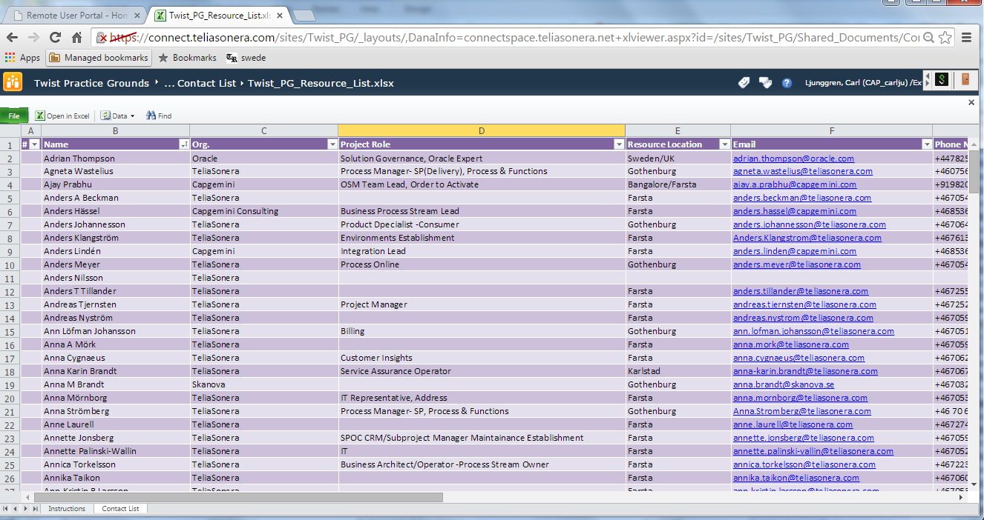
Contact list of all Twist project members and relevant TS employees
Browse to find contact
Use the link or find contact list at the “Contact list” folder under “All documents”.
Search for relevant person and get access to project role, email, phone.
If person is missing within the TS organization, use the TS intranet on a TS computer to find the relevant person.
https://connect.teliasonera.com/sites/Twist_PG/Shared_Documents/Forms/,DanaInfo=connectspace.teliasonera.net+AllItems.aspx?RootFolder=%2Fsites%2FTwist_PG%2FShared_Documents%2FContact%20List&FolderCTID=0x012000915DED2518701A40A20D48CBF65715F0&View={D3B2EE28-AD58-444F-8905-8B26BF4A0F13}

Slide 19
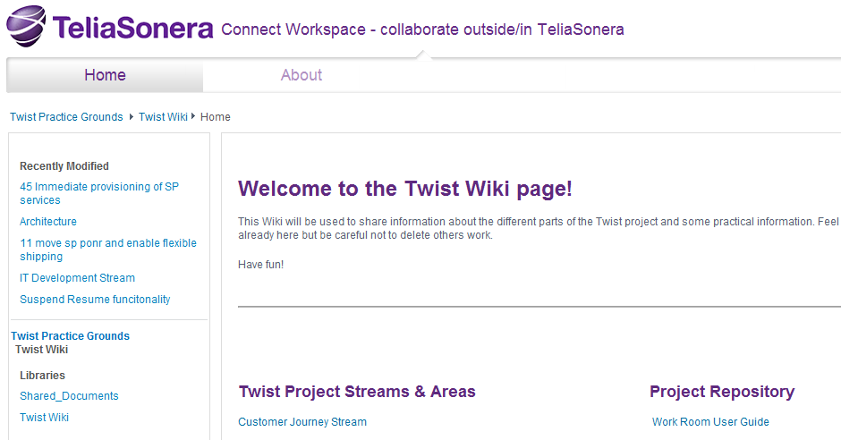
Twist Wiki - a common platform for documentation and communication
How to use the Twist Wiki?
Twist Wiki is a common platform for documentation and communication.
Open for any stream or project instance to use.

Slide 20
Working methods and tools to use -TeamForge

Slide 21

What Teamforge is and how to get access
Summary
Teamforge is one of two Project repositories which mainly are used for internal action and risk tracking, logging and maintaining Iteration Backlog.
How to access Teamforge?
Get access:
You will be provided TeamForge access during your onboarding. When access is provided please follow the instructions in the email.
Log on:
When you have been provided with access, open the below link in Google Chrome.
Enter your Capgemini CORP ID.
Enter your password.
Press ”Log on”
Point of contact:
Sukumaran Israel (sukumaran.israel@capgemini.com)
Secondary Claes Timner(claes.timner@capgemini.com).
https://coconet.capgemini.com/sf/projects/se_apps2_teliasonera_twist_2/

Slide 22
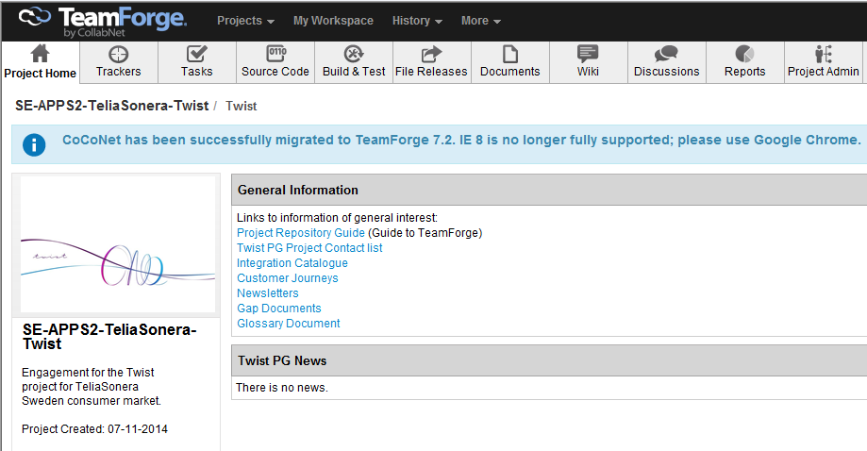
TeamForge homepage
TeamForge homepage
Here is the TeamForge homepage. The taskbar differs in layout depending on your user access. The two mostly used tabs are Trackers and Documents. Please find the TeamForge User guide here: https://coconet.capgemini.com/sf/go/doc8315916

Slide 23
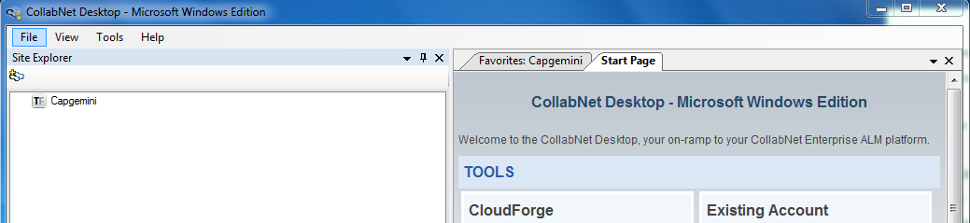
TeamForge Desktop client
Collabnet
There is a desktop client available for Teamforge users. You can find the guide how to install it here: https://coconet.capgemini.com/sf/go/doc8315916
Unlike the Web Client the Desktop Client enables you to update documents without a downloading them localy which prevents version overriding.

Slide 24
Working methods and tools to use -Time reporting in Clarity and CTR/TC

Slide 25

Clarity, the application used for project time reporting
Summary
Clarity is the application which is used in the project for planning and Timereporting.
As a project member you are required to submit your timereport every Friday. With exception from Capgemini (CC) Consultants.
How to access Clarity?
Get access:
During your onboarding you will gain access to Clarity, a confirmation will be provided by email with start up instructions.
How to Log on to Clarity:
When you’ve gained access you click the link below.
Enter your Capgemini CORP ID.
Enter your chosen password. Press ”Log on”.
Point of contact:
Sukumaran Israel (sukumaran.israel@capgemini.com)
Secondary Claes Timner(claes.timner@capgemini.com)
https://clarity.capgemini.com/niku/nu#action:projmgr.projectDefaultTab&id=10105628

Slide 26
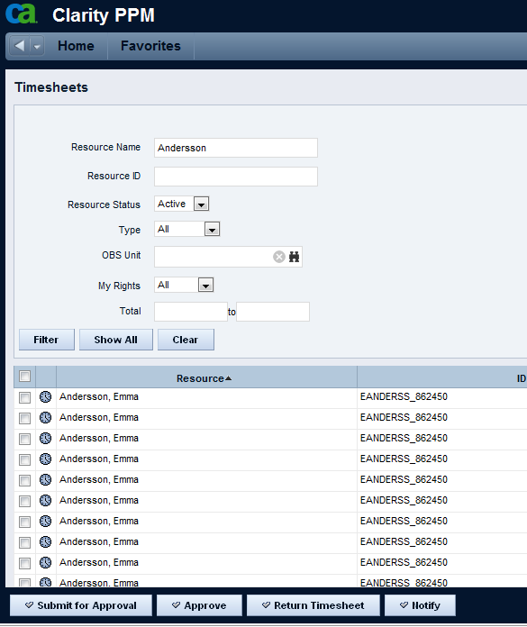
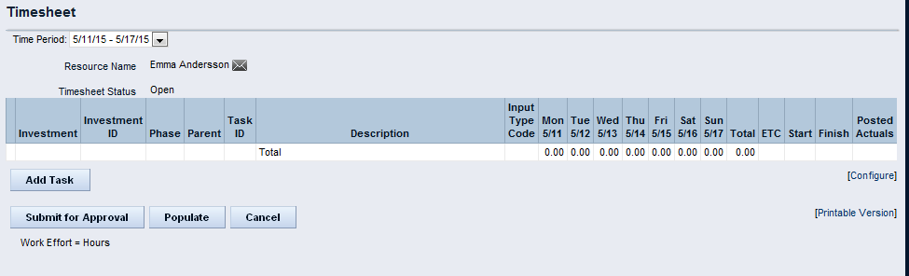
How to submit timereports in Clarity
Submit a time report:
When logged in; Press ”Home” in the upper left corner.
Choose Timesheet in the drop down list.
All your open timesheets will appear in a list in the bottom of the page.
Choose timesheet after date range by pressing the symbol of a clock next to the applicable date range.
To import the task that you want to report time on; press ”Add Task”.
In the list off tasks assigned to you, choose one or several and press ”add”.
Enter your worked hours in the matrix of days and tasks.
Press ”Save” to save the entered data.
If you have finished the task and there are still hours left in ”ETC” please set ”ETC” to 0. If you still have work to do on the task let the ”ETC” stay put.
Press ”Submit for Approval”.
Done

Slide 27


Time Reporting in CTR/ITC
For all consultants that are reporting time in Clarity its important to report the corresponding time in CTR (for onshore)/ITC (for offshore).
Ask your closest manager for project codes in CTR/ITC to report your time on.

Slide 28
Working methods and tools to use -Diva: Jira & Confluence

Slide 29
The Diva platform includes Jira & Confluence
Summary
Diva is Telia’s new project management application. At the moment Twist is using Diva in paralell with Telia Workroom.
Twist is using Jira, as a part of Diva to handle the project backlog and Confluence to manage the project documentation.
How to access Diva, Jira & Confluence
To get access to Diva with Jira and Confluence, follow this link and fill out the form to apply for access: http://diva.teliasonera.net/form/divasupport-form.html
When account is created you will be provided with emails with instructions for first log on.
If you succeed to access the applications-Congratulations!
If not, please request a firewall opening.
Point of contact:
Sukumaran Israel (sukumaran.israel@capgemini.com)
Secondary Claes Timner(claes.timner@capgemini.com)

Slide 30
Environments Access

Slide 31
VPN Access to be able to reach Telia Development Environments
VPN
Environments
VPN access is ordered in association to your onboarding. When access is provided you will receive an email with installation instructions.
After Telia VPN is provided the project onshore PMO is requesting relevant firewall openings to be done and environment accounts created for the consultant. Please contact the CM and Environments Team Lead Prasanta Dash (prasanata.dash@capgemini.com) with questions regarding environments access and your Team Lead for detailed questions regarding the environments.

Slide 32
Training & Compliance (Offshore Employees)

Slide 33
Mandatory Activities for Offshore Team Members
Training and Compliance Activities
1. Please complete the mandatory trainings mentioned in the Word document attached. You can take the Teliasonera Code of Conduct Quiz only after going through the training material mentioned in point Please confirm to sukumaran.israel@capgemini.com once done.
2. Please go through the “Training and Awareness Material” located in the Twist TROOM (https://troom.capgemini.com/sites/Twist-SDU-Access-Impl/SitePages/Home.aspx ) under the “PMO Shared Documents” folder and then take up the Teliasonera Code of Conduct Quiz. Please share your score with sukumaran.israel@capgemini.com
3. Please update the following information in the Twist TROOM (https://troom.capgemini.com/sites/Twist-SDU-Access-Impl/SitePages/Home.aspx ) under the “PMO Shared Documents” folder
Twist Personal Information Update
Twist Resource Availability Matrix – 2016 (please update your planned leaves here)
4. Please upload your resume in the attached Word and PPT in our TROOM (https://troom.capgemini.com/sites/Twist-SDU-Access-Impl/SitePages/Home.aspx ) under the “PMO Shared Documents” folder. Please note, there is a separate folder for the Word and PPT documents.
Photographs are to be clear and recent in both Word and PPT templates
Text within < > should be deleted and filled in with your details
Please take note of your name which should appear in the header section of each page (double click <First Name Last Name>)
Please ensure the “From” and “To” sections of each project are filled in
Enter certifications, project details and education in reverse chronology (latest one first)
Please name your file <FirstnameSPACELastname-EMPID.docx> and <FirstnameSPACELastname-EMPID.ppt>
Please reach out to sukumaran.israel@capgemini.com if face any difficulties

Slide 34
Practicalities -Farsta

Slide 35
Seating arrangements Farsta B3
Flexible seatings
There is flexible seating on the project floor in Farsta. This brings some rules:
Use any free seat
Clean the desk after yourself before leaving the office
If you are away from the seat more than one hour, take your belongings with you. This will enable everybody to find a seat.

Slide 36
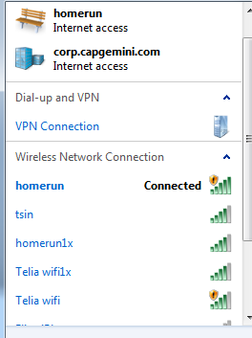
Use WiFi within TeliaSonera premises
Get access to Wifi in Farsta
Connect to Wifi “homerun” or “Telia wifi”
Open your browser
From a phone that uses a TeliaSonera sim-card:
Send text message to 44-66 with the word “Wifi”
Use generated login and password to access “homerun or Telia wifi” for Wifi connection
Click in “remember me” box to avoid having to sign in daily
From other phones:
Go to the reception in House D and ask for a 30 days voucher for Telia Wifi.

Slide 37
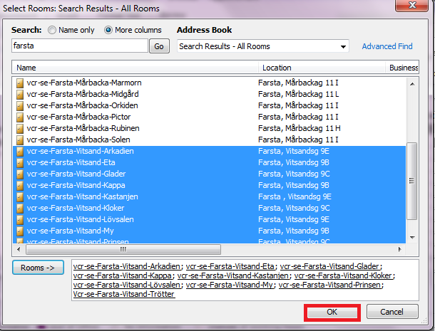
How to book meeting rooms
Book meeting rooms in Farsta
To book meetings within B-building floor 3, reserve time at the paper calendar outside the relevant meeting room
To be able to book other meeting rooms you will need a Telia computer
Booking conference rooms:
Open the calendar in outlook
Press ”New Appointment” in the upper left side of the top bar.
Add applicable information for the meeting
Press Scheduling Assistance on the top bar
Press ”Add rooms...” in left down corner
Right ”Farsta” in the search field and press ”Go”
Scroll down to Rooms to Vitsandsgatan
Choose applicable meeting room in accessible buildings
Lync is the preferred conference call software

Slide 38
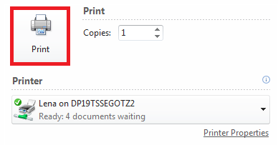
How to print
Printing in Farsta
If you have a Telia computer and you are at Vitsandsgatan you can connect to the Telia printers. You will have to ask for a printer tag in the reception and then follow the instructions on the wall of the printer room.
You can choose any of the following printer line: SP on 131.115.251.130
Press “Print”
Place the printer tag on the closest Telia Printer to connect to your account.
You trigger the job by pressing “My Print Jobs” at the printer touch screen.
If you do not have a Telia computer you will have to ask a colleague who does and then email the document to him/her for printing.

Slide 39

How to get access card to TeliaSonera buildings
Get access to Wifi
When a new (onsite) project member is onboarded an access card is ordered by Capgemini PMO. This process can take up to 3 weeks before the card arrives. You will receive an email from the reception when the card is delivered. Collect card and find the information for activation attached in the envelope.
The card will enable you to access the main gate 05:30-18:00 and House B. If you do not have an access card, you will need to be let in by a colleague.

Slide 40
Welcome to TWIST!

